Slide 1

RESTful Web Services Concepts

Slide 2
Agenda
Web services characteristics
HTTP Concepts
HTTP Methods
HTTP Status codes
Web Services URI types
Web Services CRUD operations
Method Idempotence and Non-Idempotence
REST Response (XML & JSON)

Slide 3
Online APIs
www.twitter.com
For human consumption (HTML Format)
api.twitter.com
For code consumption (XML / JSON format)
Developer uses this data, converts into object or their data structure

Slide 4
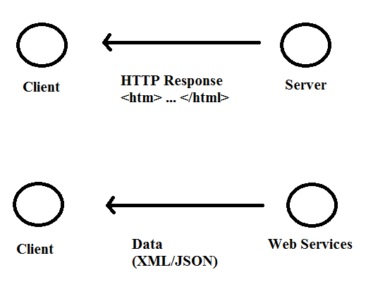
Web Services Characteristics
1. HTTP Exchange
Client uses its own logic to format this data <html>….</html>

Slide 5
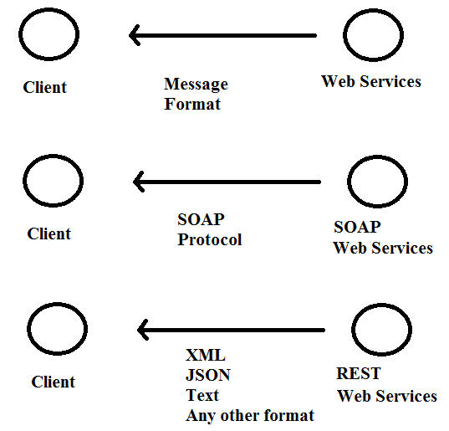
Web Services Characteristics
2. Protocol
For REST web services, there is no specific format as long as both client and server understand each other

Slide 6
Web Services Characteristics
3. Service Definition
For SOAP, it is WSDL
For REST, there is none
For REST, There is equivalent of WSDL, called WADL, but it didn't really catch up.
So, not many users are using this.
So, let’s take this as for REST, there is none for service definition

Slide 7
What is REST?
Stands for REpresentational State Transfer
It’s not about web services at all
It’s an architectural style
It’s a set of guidelines
You can use these styles in any application
If you apply these styles in developing web services, then that is called RESTful web services ☺
REST + Web services = RESTful Web services

Slide 8
REST and HTTP
HTTP is all about exchange and communicate information online
The text which is transferred is called hyper text
So, the protocol is Hyper Text Transfer Protocol
Hyper text is a structured text
The language to create hyper text is HTML

Slide 9
HTTP Concepts
Resource Locations
HTTP is all about locating the resources using hyper links.
Action Based URIs:
weather.com/lookUpWeather.do?pinCode=560102
(Seems that server is doing something here – very visible)
Resource Based URIs:
weather.com/pinCode/560102
(Seems that server is not doing anything here – We are just peeking the resource which is available over there)
Saw and felt the difference ???

Slide 10
HTTP Methods
They are methods or verbs used to interact with the URLs.
GET – Retrieve data from the server
POST – Send the data to the server
PUT – Also, used to send the data, some difference – let’s see later
DELETE – Remove resources from the server
Use the right methods to do the right things
Don’t use DELETE method to retrieve the data – does not make any sense ☹

Slide 11
HTTP Metadata
Data about data
Extra information from the server like status code 200
Every response contains metadata.
200 – successful
500 – server error
404 – page not found

Slide 12
Format of data in web services?
The format of the response could be
XML
JSON
TEXT
Some other format
The client asks for certain format, and the server sends the data in that format
This is called CONTENT NEGOTIATION

Slide 13
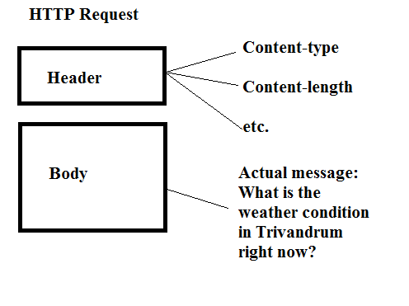
HTTP Request

Slide 14
So far….So good…
Short summary:
Resource based URI – Every resource should be identified by a single URI
Choose the right HTTP methods depends on the operations
Response should return correct HTTP status codes (404, 500, 200 etc)
All request and response should have the message headers (meta-data like content type)

Slide 15
Designing RESTful web service
Messenger – A social media application API
Can post messages
Like other messages
Comment other messages
Share other messages
User profiles
So, some of the entities could be:
User, Message, Comment, Share, Like

Slide 16
Web application URI
Use case:
Retrieve the message with the id 10
If it is web application, the URI would be:
/getMessage.do?id=10
or
/retrieveMessage.action?id=10

Slide 17
Static pages
As per RESTful web services, every resource should be identified by unique URI
Consider the following static pages for 5 profiles:
Guru.html
John.html
Leo.html
Arvind.html
Lakshmi.html
You would create profiles directory and place all of the above html under this.

Slide 18
RESOURCE based URI
If you drop the html part, then you will get RESOURCE based URI
/profiles/Guru
/profiles/John
/profiles/Leo
/profiles/Arvind
/profiles/Lakshmi
To make it generic:
/profiles/{profileName}
Always, create unique URI for the resources

Slide 19
Creating unique URIs for messages
/messages/{messageId}
/messages/10 → Retrieves the message for id 10
/messages/20 → Retrieves the message for id 20
Note that this URI contains nouns, not verbs as web application.
So, when you design RESTful web services, use nouns
Also, note the plural forms (messages, profiles, comments, likes, shares)

Slide 20
Everything is a RESOURCE
In RESTful web services, everything is a RESOURCE.
Identify the entities/nouns – Assign unique URI to them
There is no such thing like getMessage.do or getMessage.action or message?id=5, or query parameters etc.
They don’t have any significance to the clients, do they?

Slide 21
Ok, Think about message relations now…
If you want to retrieve comment with id 3 for the message with id 4, what would be the URI?
Keep in mind that comments belong to messages
So, how would you design this?
How your folder structures would look like?

Slide 22
Web Services URI types
Instance Resource URIs
Collection Resource URIs

Slide 23
Instance Resource URIs
Instance Resource URIs
/messages/1
Here, messages is the instance
1 is the id
/comments/2
Here, comments is the instance
2 is the unique id
It identifies what types of instance (comments/messages/likes/shares) you are interested in.

Slide 24
Collection Resource URIs
If you want to get all messages, then? ☹
Could be something like this??
/messages
Or want to get all the comments for message 2
/messages/2/comments
They don’t refer to particular resource, rather collection of resources
So, they are called collection resource URIs
Usually, they are plurals like messages, profiles, likes, shares, comments etc.

Slide 25
Use only HTTP methods
In RESTful web services, use only the HTTP methods for all operations like retrieve, update, delete, create
Something like this
/getMessages.do?id=10 → /messages/10
/postMessages.do?id=10 → /messages/10
/deleteMessages.do?id=10 → still /messages/10
Wondering, how it would be possible?
The answer is __________

Slide 26
CRUD operations
To Get a message:
Send GET request for messages/10
To Update a message:
Send PUT request for messages/10
To delete a message:
Use DELETE request for messages/10
To create a message – hang on:
This is the responsibility of the application
So, the URI would be: /messages
The application creates the message in the messages folder, assigns a unique id and sends this id to the client.

Slide 27
Can you answer this?
GET request for /messages
DELETE request for /messages/10/comments
GET request for /messages/10/comments
PUT request for /messages/2/likes
Similarly, POST works:
POST request for /messages/10/comments
Creates a new comment for message id “10”
PUT request for /messages/20/comments
Replaces all comments for the message id “20”

Slide 28
Method Idempotence
GET – Read only method
Any number of times you call this method, or send this request, won’t affect the RESOURCE at all
So, this is REPEATABLE read
This is SAFE

Slide 29
Method Idempotence
How about DELETE request?
DELETE request for /messages/10
First time, the message with id “10” is deleted
If you issue the same request for 2nd time, then?
PUT request for /messages/10
First time, the message with “10” will be replaced
If you issue the same request for 2nd time, then?
They are idempotent methods

Slide 30
Non-idempotent method
How about POST request?
POST request for /messages
First time, the new message created with some id “11”
Second time, again new message created with another id “12”.
So, every time, this will create a new resource
Not safe – So POST is not idempotent method
Safely repeatable - GET, PUT, DELETE (Idempotent method)

Slide 31
Idempotence – Wikipedia definition
Idempotence is the property of certain operations in mathematics and computer science, that can be applied multiple times without changing the result beyond the initial application
Not repeatable - POST (non-idempotent method)
That is why resource creation should be always with POST method.
PUT is idempotent
POST is non-idempotent
This is the standard

Slide 32
REST response
In case of RESTful, the response is only data (without any formatting)
JSON is light weight compared to xml data
If it is web application, The Response will be HTML + styling + CSS
JSON is much more verbose, light weight, compatible , gaining popularity.
Since the client is mostly the browser, so JSON is the popular format of exchanging the data

Slide 33
The MessageEntity
Consider this class:
public class MessageEntity {
private long id;
private String message;
private Date created;
private String author;
}

Slide 34
JSON Response
So, when the request URI comes for looking message with id 10, the response will be:
{
"id":"10",
"message":"Hello REST",
"created":"2015-08-23",
"author":"Guru"
}
If you want more details on how to work on JSON, visit this web site: http://www.jsoneditoronline.org

Slide 35
XML Response
If the client wants XML format, the same data will look like this:
<messageEntity>
<id>10</id>
<message>Hello REST</message>
<created>2015-08-23</created>
<author>Guru</author>
</messageEntity>

Slide 36
How REST gets its name…
Let's see later how a client can request for specific format (JSON or XML)
Same resource - but different format.
Different representation of same resource
That's how REST gets its name - REpresentational State Transfer
You are transferring the representational state of the resources.
If the client wants "xml please", if the server doesn't have that format, it could return JSON, ignoring the client request.

Slide 37
HTTP Status codes
Status of REST response - Very first line of the response is status code
200 ok
404 Not Found
It's better to remember certain status codes:
It starts with 100 and ends with 599 (1xx to 5xx)
Five different classes of status codes

Slide 38
Classification of status codes – 1xx
1xx
Information codes (1 indicates what class the code belongs to) – acknowledgement responses,
we are not going to use this

Slide 39
Classification of status codes – 2xx
2xx - Success codes
200 - ok
201 - created (successful resource created) - like message created
204 - No content (delete request, delete resource - you don't need to send anything back)
The server no need to send anything back to the client

Slide 40
Classification of status codes – 3xx
3xx - Redirection codes
Server asks the client to take certain steps to complete the request
302 - Found
307 - Temporary redirect (Don't ask me, ask other server)
304 - Not modified (like the resource already sent, the client asking again, the server just saying couple of minutes back I sent you the resource, since then the resource has not been modified)

Slide 41
Classification of status codes – 4xx
4xx - Client error
If the client request contains some errors like client request has syntax errors.
400 - Bad request (server not understood the client's request)
401 - Unauthorized (clients need to sign in)
403 - Forbidden (no right access)
404 - not found
415 - Unsupported Media Type (the server not u/stood the language spoken by client)

Slide 42
Classification of status codes – 5xx
5xx - server error
The server screws up something when sending the response back.
500 - Internal Server error - The client request is accepted, the request exists, but something
went wrong when processing the request.
Example. RuntimeException when running Java Code.

Slide 43
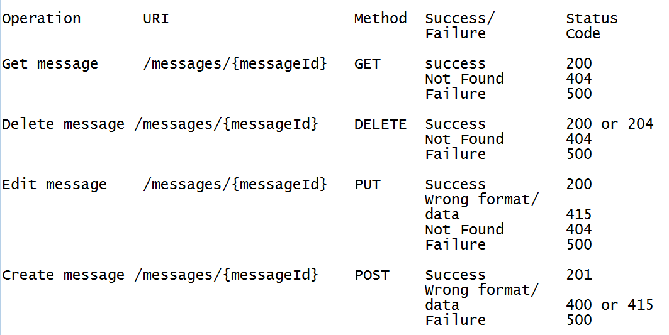
Status codes for CRUD operations

Slide 44
Some REST API for testing
https://reqres.in/
http://dummy.restapiexample.com/

Slide 45
T
H
A
N
K
Y
O
U

